Slide 1

MEENAKSHI COLLEGE OF ENGINEERING
SMART E-UNIFORM FOR SOLDIERS USING IOT
GUIDE NAME
Ms. MONISHA PJ
Asst.Prof.
BY
PRAKASH.P
MCA
311423622035

Slide 2
ABSTRACT
Soldiers works in extreme weather conditions and hazardous environment during their service.
To support their well-being, a smart E-uniform with climate-adjustable features has been developed.
This uniform works in both summer and winter modes, helping soldiers regulate body temperature.
It includes essential components like sensors, a microcontroller, power supply and heating/cooling systems.
The system continuously monitors the body and environment to activates temperature control as needed.

Slide 3
OBJECTIVES
To develop a survival system for soldiers in extreme hot and cold environments.
To integrate a health monitoring system and automated climate control into a compact, wearable uniform.
To display real-time sensor data and system status on an LCD screen.
To send instant alert to the command center through MQTT protocol, E-mail and SMS.
To allow higher authorities to remotely monitor each soldier through transmitted data.

Slide 4
COMPANY PROFILE
Pantech Solutions is a leading technology-driven company through innovative learning and development platforms.
The team at Pantech is powered by a strong foundation in technological innovation and mathematical problem-solving skills.
Headquartered in Chennai, the company offers a wide range of industry-aligned services, training programs, and real-time project support.
The organization adheres to global standards, best practices and high-quality educational outcomes in the field of technology.

Slide 5
HARDWARE REQUIREMENTS
Microcontroller
Temperature Sensor
Ultra sonic sensor
Gas Sensor
Peltier panel
Fan
Relay
LCD
Arduino IDE
Think speak(Data visualization)
SOFTWARE REQUIREMENTS

Slide 6
INTRODUCTION
Soldiers face extreme weather, climate-related illnesses, and environmental hazards while serving the nation.
They have threats like toxic gases, intense heat, and unforeseen obstacles pose serious risks.
This project aims to address these challenges and introducing a revolutionary solution by this E-uniform.
The uniform adapts to changing conditions, ensuring comfort and protection.
It features real-time environmental sensing, thermal control, and IoT-based monitoring.

Slide 7
LITERATURE SURVEY
TITLE | AUTHOR | DESCRIPTION
Phase Change Materials for Thermal Regulation in Military Clothing. | Cho, Y., Kim, H., & Lee, J. (2023). | Phase Change Materials (PCMs) are advanced materials that absorb, store, and release thermal energy during phase transitions (e.g., solid to liquid and vice versa).
Gas Sensor-Based Environmental Monitoring for Soldier Safety. | Patel, V., Sharma, B., & Khan, A. (2022) | A Gas Sensor-Based Environmental Monitoring System for Soldier Safety is designed to detect harmful gases in the surroundings and provide real-time alerts to soldiers or command centers.
Infrared Sensor Applications in Low-Visibility Environments. Journal of Sensor Technology | Kim, D., Park, S., & Choi, M. (2022) | An Infrared Sensor-Based System for Low-Visibility Environments is designed to assist navigation, object detection, and threat identification in conditions where human vision is impaired, such as fog, smoke, or darkness.

Slide 8
EXISTING SYSTEM
Solar E-Uniform project is early prototype designed for soldiers monitor their body temperature using IoT technology.
The uniform is equipped with: Arduino Uno R3 microcontroller (as the central control unit).
It includes a DHT11 temperature sensor and a solar panel, which powers the Arduino and sensors.
The temperature sensor collects real-time data from the soldier's body or environment and displays it on an LCD screen.
It can only detect temperature and lacks advanced features like thermal regulation, gas detection, or remote alert transmission.

Slide 9
DISADVANTAGE OF EXISTING SYSTEM
Solar panels are unreliable during nighttime, indoors, or in poor weather.
No integrated Wi-Fi or real-time alert/visualization system.
Only monitors temperature; lacks active cooling or heating functionality.
Added solar panels increase weight, reducing comfort and mobility.
No built-in hazard detection or security features, limiting effectiveness.
7/16/2025
9

Slide 10
PROPOSED SYSTEM
A smart embedded system designed for soldiers operating in extreme and hazardous environments.
It use NodeESP8266 as microcontroller with built-in Wi-Fi module for faster and more efficient processing..
Ultrasonic sensor is embedded to detect nearby objects or moving threats, improving safety in low visibility.
Gas sensor continuously monitor the presence of harmful gases (e.g., CO, methane, HCN).
Peltier module controls heating or cooling of the uniform based on the temperature.
Sends real-time data (temperature, gas levels, obstacle) to cloud dashboard.

Slide 11
ADVANTAGES OF PROPOSED SYSTEM
It has built-in wireless communication and faster processing.
Combines health monitoring, environmental sensing and smart control in one compact system.
It uses rechargeable batteries instead of heavy solar panels for better movement.
Allows real-time monitoring by commanders through a cloud platform(Thing speak).
Detects harmful gases instantly to avoid health risks.
Continuously monitor the environment and trigger alerts in case of danger.

Slide 12
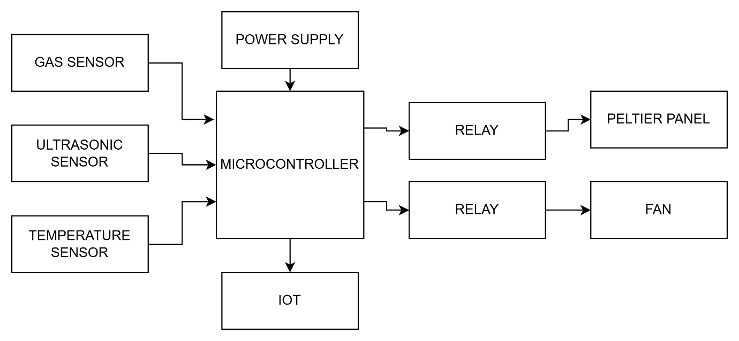
BLOCK DIAGRAM

Slide 13
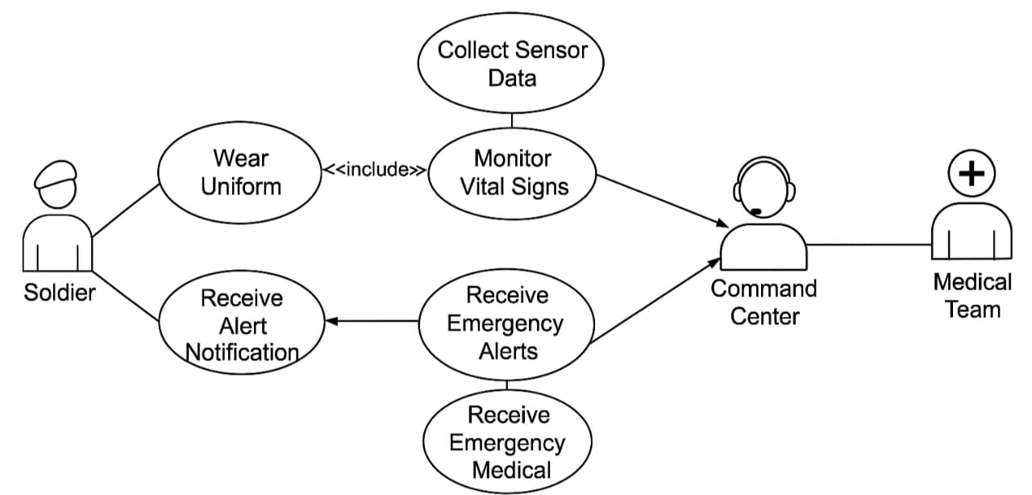
USE CASE DIAGRAM

Slide 14
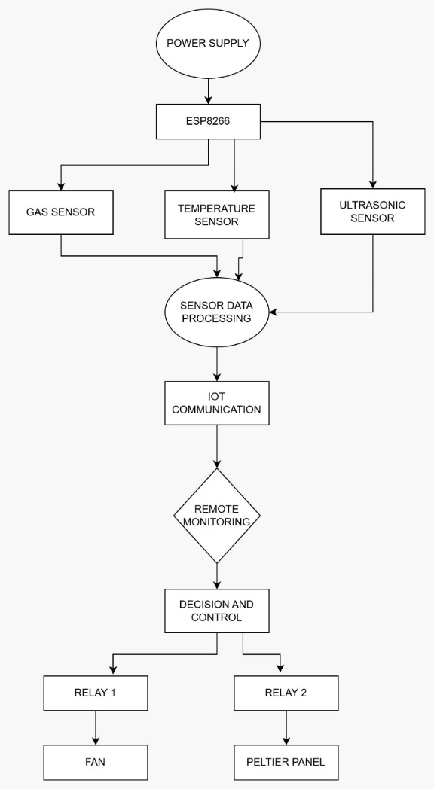
WORK FLOW DIAGRAM

Slide 15
IMPLEMENTATION OF PROPOSED SYSTEM
MODULES
Ultra sonic sensor
Gas sensor
Temperature sensor
Relay
Peltier panel
Thermal Fan
LCD
Emergency Alert system
Real-time monitoring using Think speak.

Slide 16
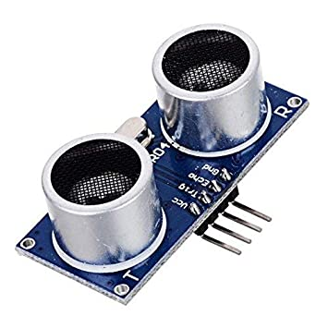
ULTRASONIC SENSOR
Ultrasonic sensor is used to measure a distance of the object using sound waves.
It emits ultrasonic waves, typically in the range of 20 kHz to 65 kHz.
It detect nearby or moving object that cause threat to the soldier in field.
The measured distance can be displayed on LCD screen to alert soldiers.
The distance is calculated and presented in centimeters (cm).

Slide 17
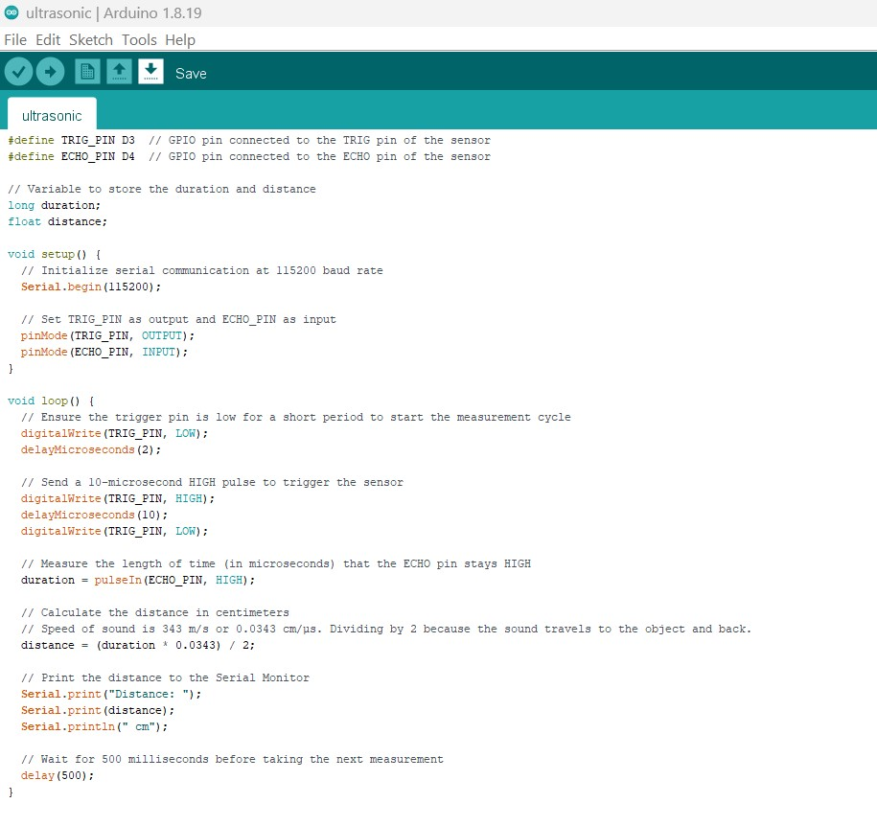
ULTRASONIC SENSOR
The ultrasonic sensor detects objects by executing code instructions, as shown in the image:

Slide 18
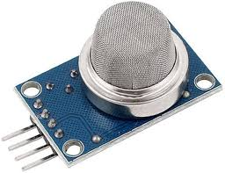
GAS SENSOR
A gas sensor detects & measures the concentration of toxic gases in the environment.
The MQ135 gas sensor is used in the E-uniform to protect soldiers from harmful gases.
Sensor readings are displayed on LCD screen, warning soldiers of hazardous air conditions.
An alert is triggered when gas levels exceed a defined threshold (e.g:gas level > 500).
The gas concentration is shown as a percentage, offering accurate real-time monitoring.

Slide 19
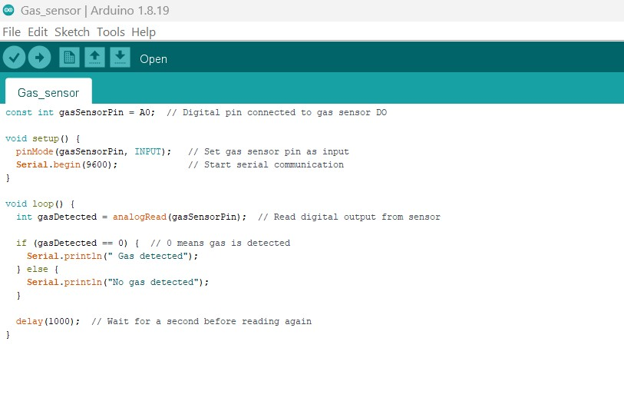
GAS SENSOR
The gas sensor can be programmed using Arduino IDE, as shown in the image:

Slide 20
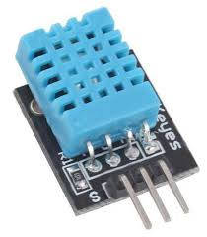
TEMPERATURE SENSOR
DHT 11 sensor continuously measures ambient temperature and humidity around the soldier.
Microcontroller processes the data and send to Thing speak via Wi-Fi.
If temperature exceeds 35°C, the system performs two actions:
Sends an automatic alert to the base station.
Activates a cooling system (e.g., peltier module and fan) to cool the soldier.
This prevent heat exhaustion, hyperthermia, and high humidity exposure in extreme environment.
Soldiers can view real-time temperature data on an LCD screen with high accuracy.

Slide 21
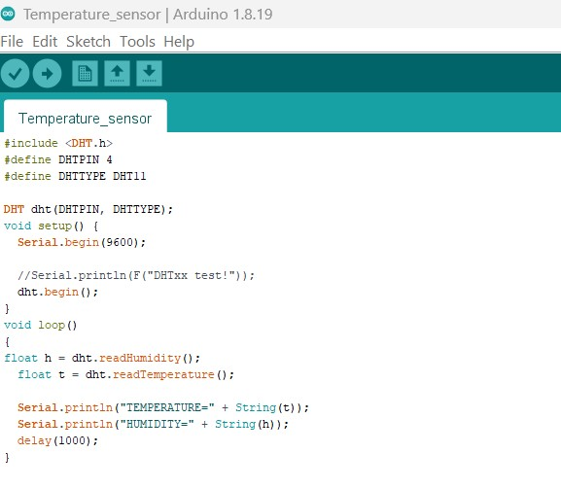
TEMPERATURE SENSOR
The temperature sensor code is developed in Arduino IDE as shown below:

Slide 22
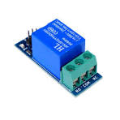
RELAY
A relay is an electrically controlled switch that allows a low-power microcontroller to operate high-power devices.
The ESP8266 works on 3.3V logic and cannot directly drive high-current components.
Relays enable automated power control for devices like peltier modules and cooling fans.
They provide isolation between ESP8266 and high-power output, ensuring safe operation.

Slide 23
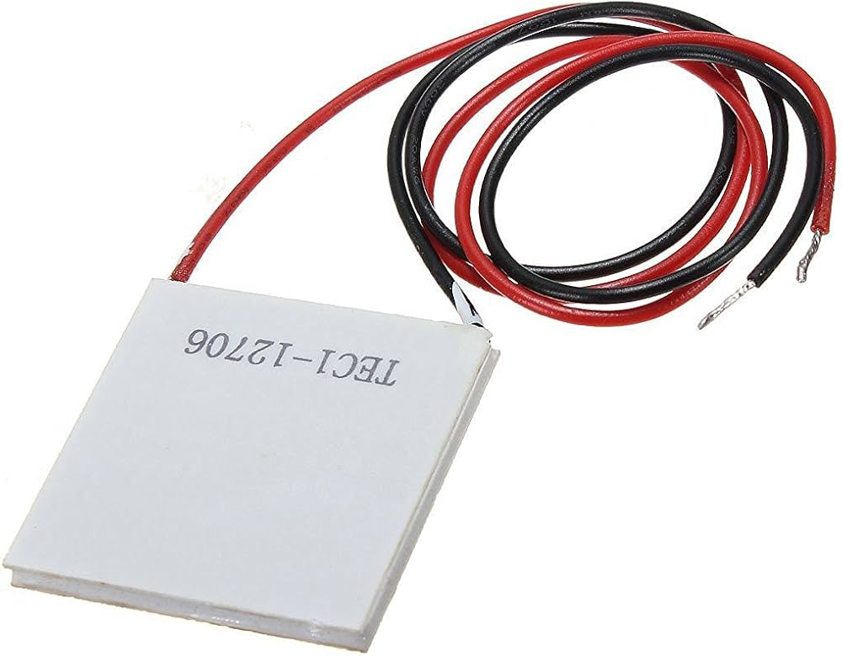
PELTIER PANEL
Peltier panel protect soldiers from extreme temperatures and prevents unconsciousness.
It activates heating or cooling based on body temperature changes detected by sensors..
If temperature exceeds 35°C, it creates a cooling effect.
If temperature drops below 29°C, it generates a warming effect.
One surface provides thermal effect, while other side generate cooling effect.

Slide 24
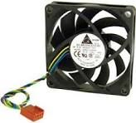
THERMAL FAN
Thermal fan refers to cooling fan controlled by adjusts speed based on condition.
It prevents overheating caused by the Peltier panel during extreme temperatures.
If the fan slow down or stops, the system triggers an alert or off power using a relay.
Operates similarly to cooling fans in laptops or PCs, ensuring efficient heat management.

Slide 25
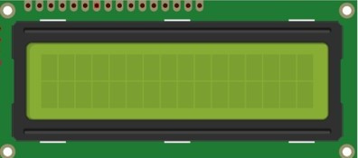
LCD
LCD (Liquid Crystal Display) is a display module commonly used IoT applications..
It shows vital information like obstacle alerts, temperature and explosive detection.
A 16×2 LCD is used, displaying 16 characters per line across 2 lines.
Each character is shown using a 5×7 pixel matrix..
The LCD operates using two registers: Command and Data.

Slide 26
EMERGENCY ALERT SYSTEM
The E-uniform triggers three types of emergency alerts based on the distance between the soldier and the base station:
Short Range:
MQTT (Message Queuing Telemetry Transport) is a lightweight messaging protocol used for real-time communication.
Sensor data (temperature, gas, distance) is sent instantly to the base station via MQTT for immediate monitoring.
Medium Range :
Email Alert is sent.
A complete status report is emailed to the control center using internet-based SMTP services.
Long Range:
SMS Alert is triggered via GSM network using Twilio.
A short, urgent text message is sent to base station for ensure timely action.
The base station can forward these alert to rescue teams for ensure the soldier’s safety .

Slide 27
REAL-TIME MONITORING VIA THING SPEAK
Thing Speak is an IoT platform used to collect and monitor sensor data.
Sensor data from the microcontroller is sent to Thing Speak for visualization and monitoring by higher officials.
Data is displayed using graphs or widgets for specific channels and fields.
Officials can track each soldier’s health and status, and take action if unusual readings are detected. .
The system monitors parameters like distance (ultrasonic sensor), gas levels, and temperature in real time.

Slide 28
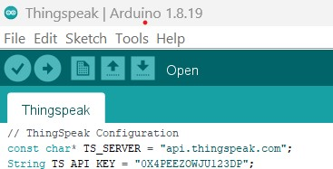
REAL-TIME MONITORING VIA THING SPEAK
Below is a sample code snippet showing how to configure the server and API key in Arduino IDE:

Slide 29
CONCLUSION & FUTURE ENHANCEMENT
The smart E-uniform enhances soldier safety, comfort, and security in extreme conditions using IoT.
It integrates temperature control, gas, and ultrasonic sensors with a Peltier panel to transmit data to the cloud (Thing Speak).
This system improves operational efficiency and response time in critical areas..
Future upgrades may include real-time video monitoring using an ESP-32 camera and precise location tracking with a NEO-M9N GPS module.

Slide 30
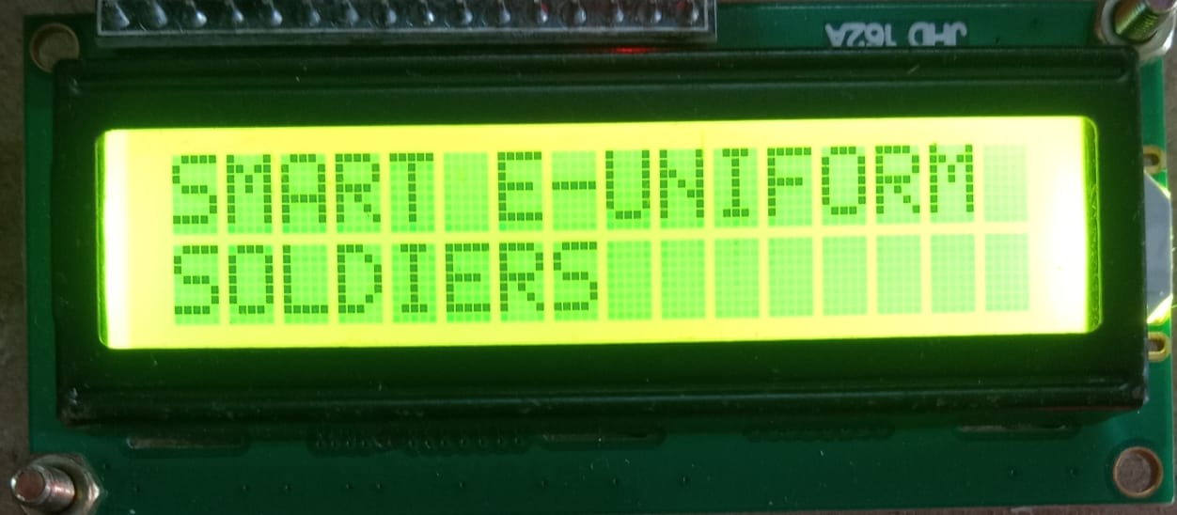
SAMPLE SCREEN
WELCOME SCREEN

Slide 31
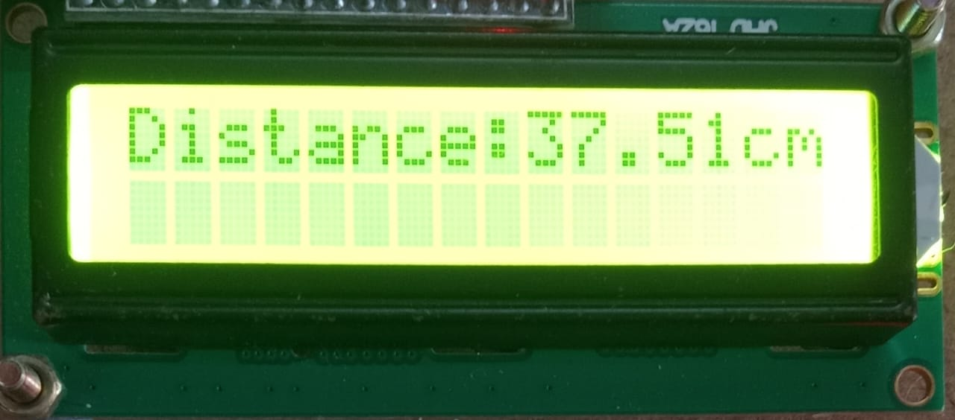
REAL-TIME DISTANCE DATA

Slide 32
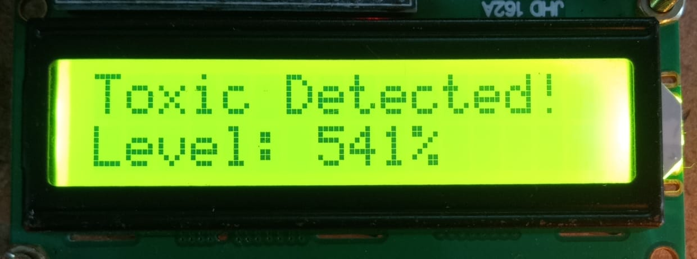
TOXIC GAS DETECTION SCREEN

Slide 33
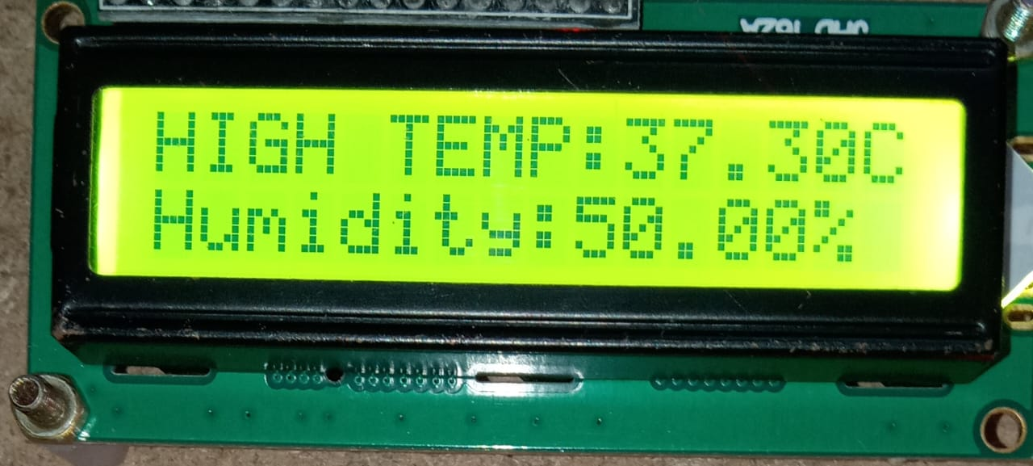
REAL-TIME TEMP & HUMIDITY DATA

Slide 34
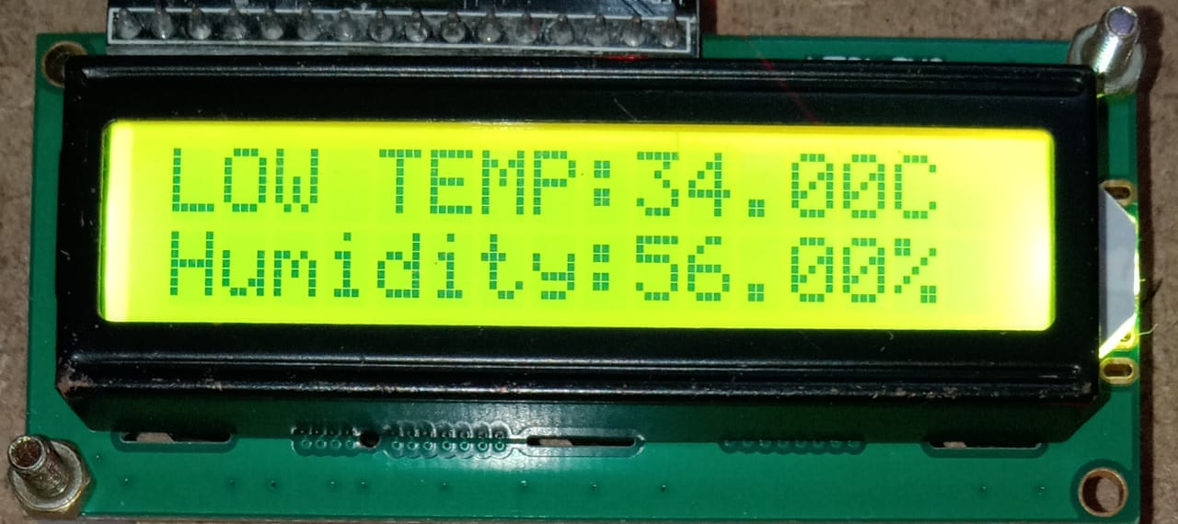
REAL-TIME TEMP & HUMIDITY DATA

Slide 35
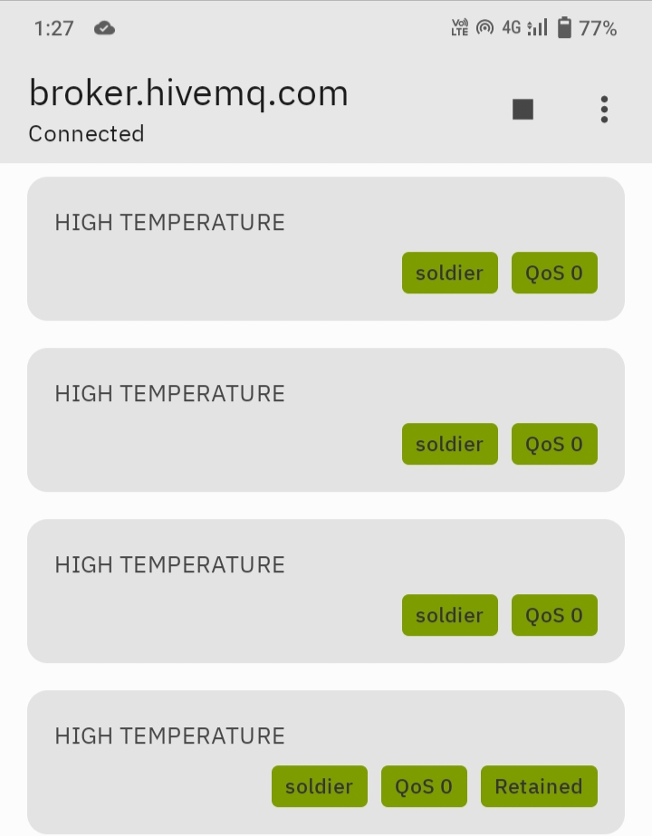
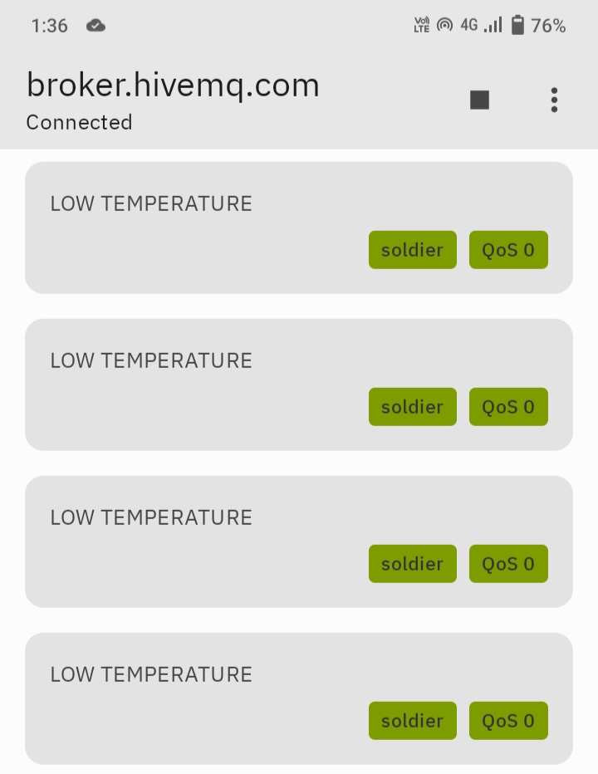
EMERGENCY ALERT SYSTEM
MQTT Alert for High & Low temperature.

Slide 36
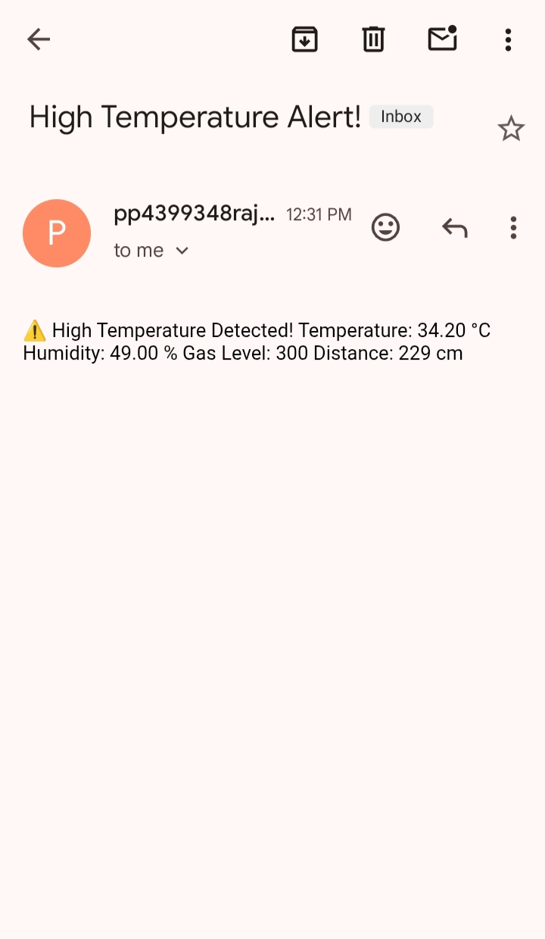
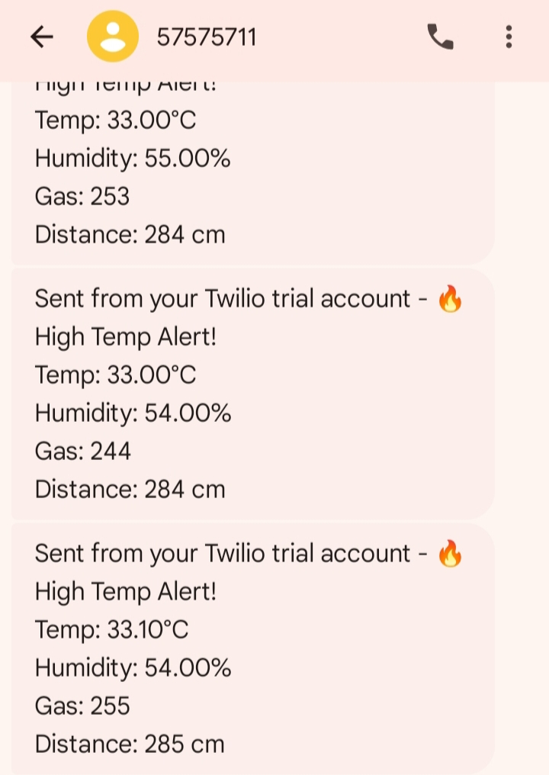
EMERGENCY ALERT SYSTEM
E-mail Alert & SMS Alert for both high and low temperature.

Slide 37
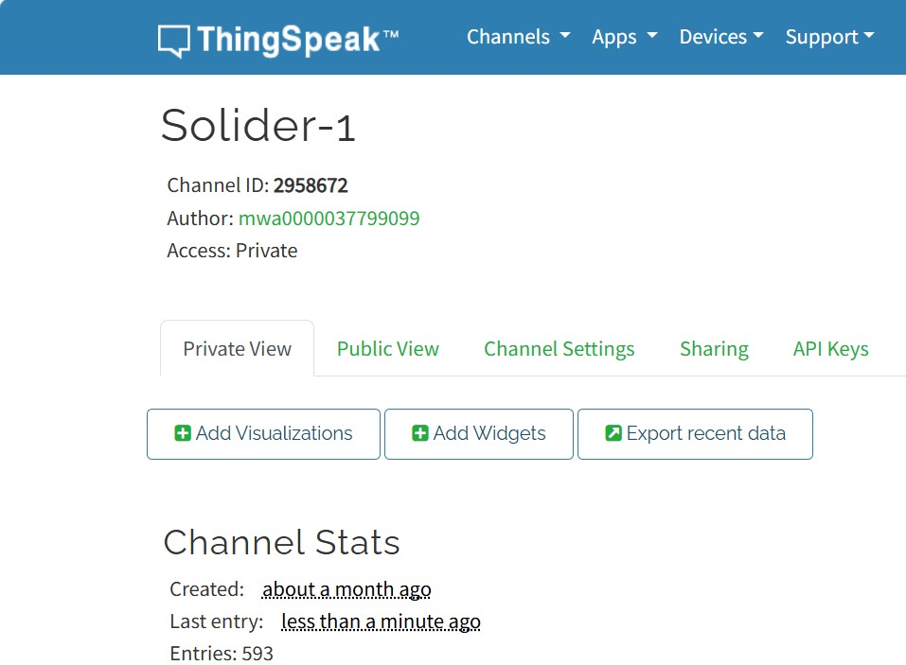
THINGSPEAK DASHBOARD OF SOLDIER

Slide 38
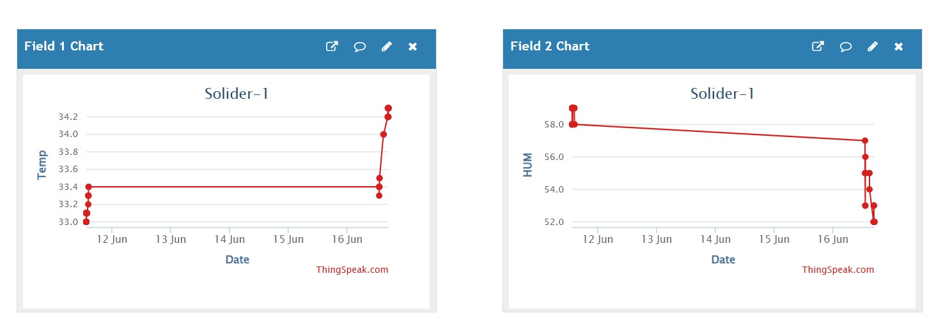
THINGSPEAK-BASED VISUALIZATION
Graphical Analysis of Temperature & Humidity of individual soldier.

Slide 39
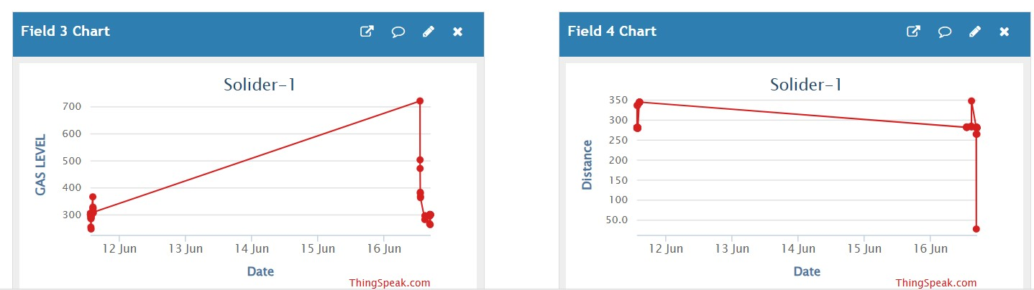
THINGSPEAK-BASED VISUALIZATION
Graphical Analysis of Gas & Obstacle Detection data.

Slide 40
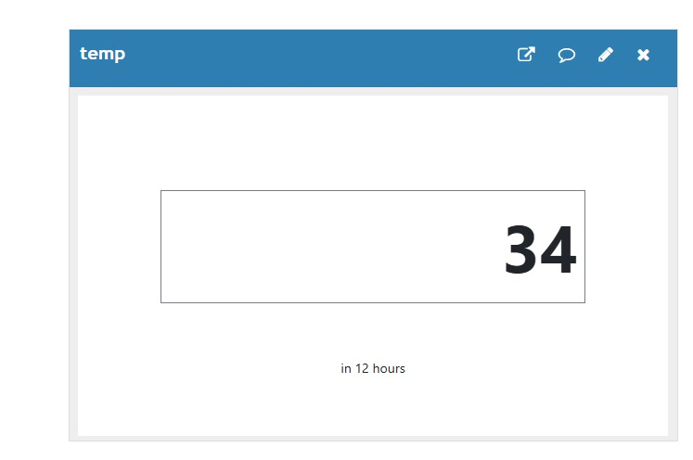
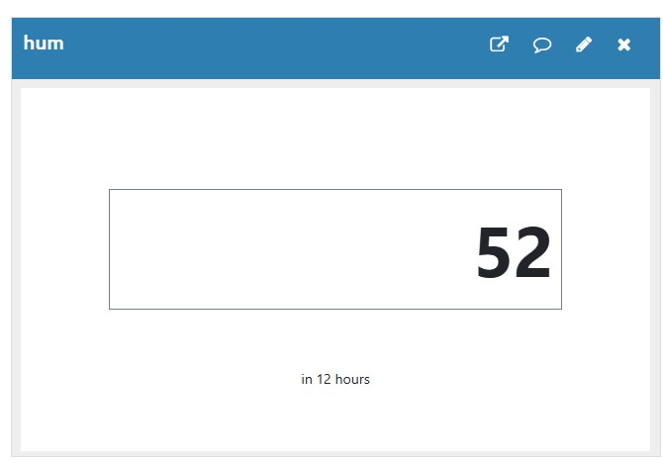
THINGSPEAK WIDGETS OF SENSOR VALUES

Slide 41
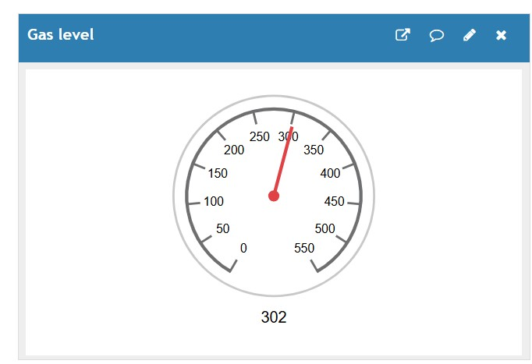
THINGSPEAK WIDGETS OF SENSOR VALUES

Slide 42
REFERENCES
Vignesh. A; C. Bhuvaneswari; Shiva M; W. Abitha Mamala; M. Pushpavalli; M. Kavitha, Intelligent Solar Based Climate Adjustable E-Uniform for Soldiers, 2023 International Research journal on Advances in Computing, Communication and Applied Informatics.
Jeeva B; Bangi Karuna Sree; Basineni Udaya Priyanka; Divyadarshini S; Hema. S, Smart E-uniform for Soldiers, 2023 7th International Research Journal on Design Innovation for 3 Cs Compute Communicate Control.
S. Ramesh, Dr R.Sankar Ganesh, N. Dharani and P. Kandeepan, "Climate Adjustable E- Military Suit", International Research Journal of Modernization in Engineering Technology and Science, March 2023.

Slide 43
REFERENCES
Chowdam Anila; Ashok Kumar. N; Eduru Joel Vittan; Bheemaneni Uma Maheswara Chowdary; Dhanya Sree Bala Subramani; Balamanikandan. A, Sun-Powered Tactical Uniforms for Soldiers in Military Applications, 2024 10th International Journal on Advanced Computing and Communication Systems.
Rahul Khairamode, Rahul Khangouka and Rutik Patil, "Design And Fabrication Of Solar Based E-Jacket For Soldiers", International Journal of Engineering Technology and Management Sciences, July 2022.
Dipali H. Kale, Yogita P. Phapale, S. Kamble Shivani and S. L. Shirke, "Solar Based E-Uniform for Soldiers", International Research Journal of Engineering and Technology (IRJET), May 2022.

Slide 44
THANK YOU

